Slide 1
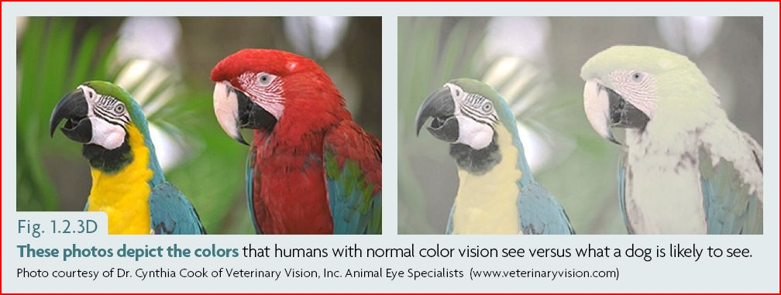

Slide 3
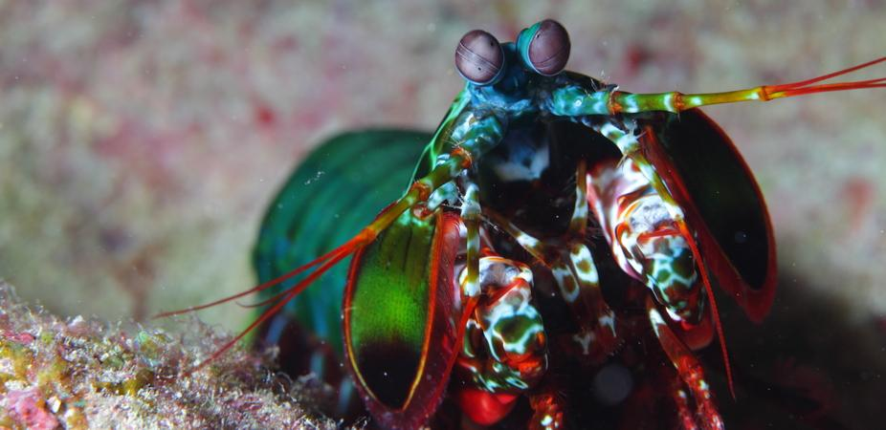

Slide 4
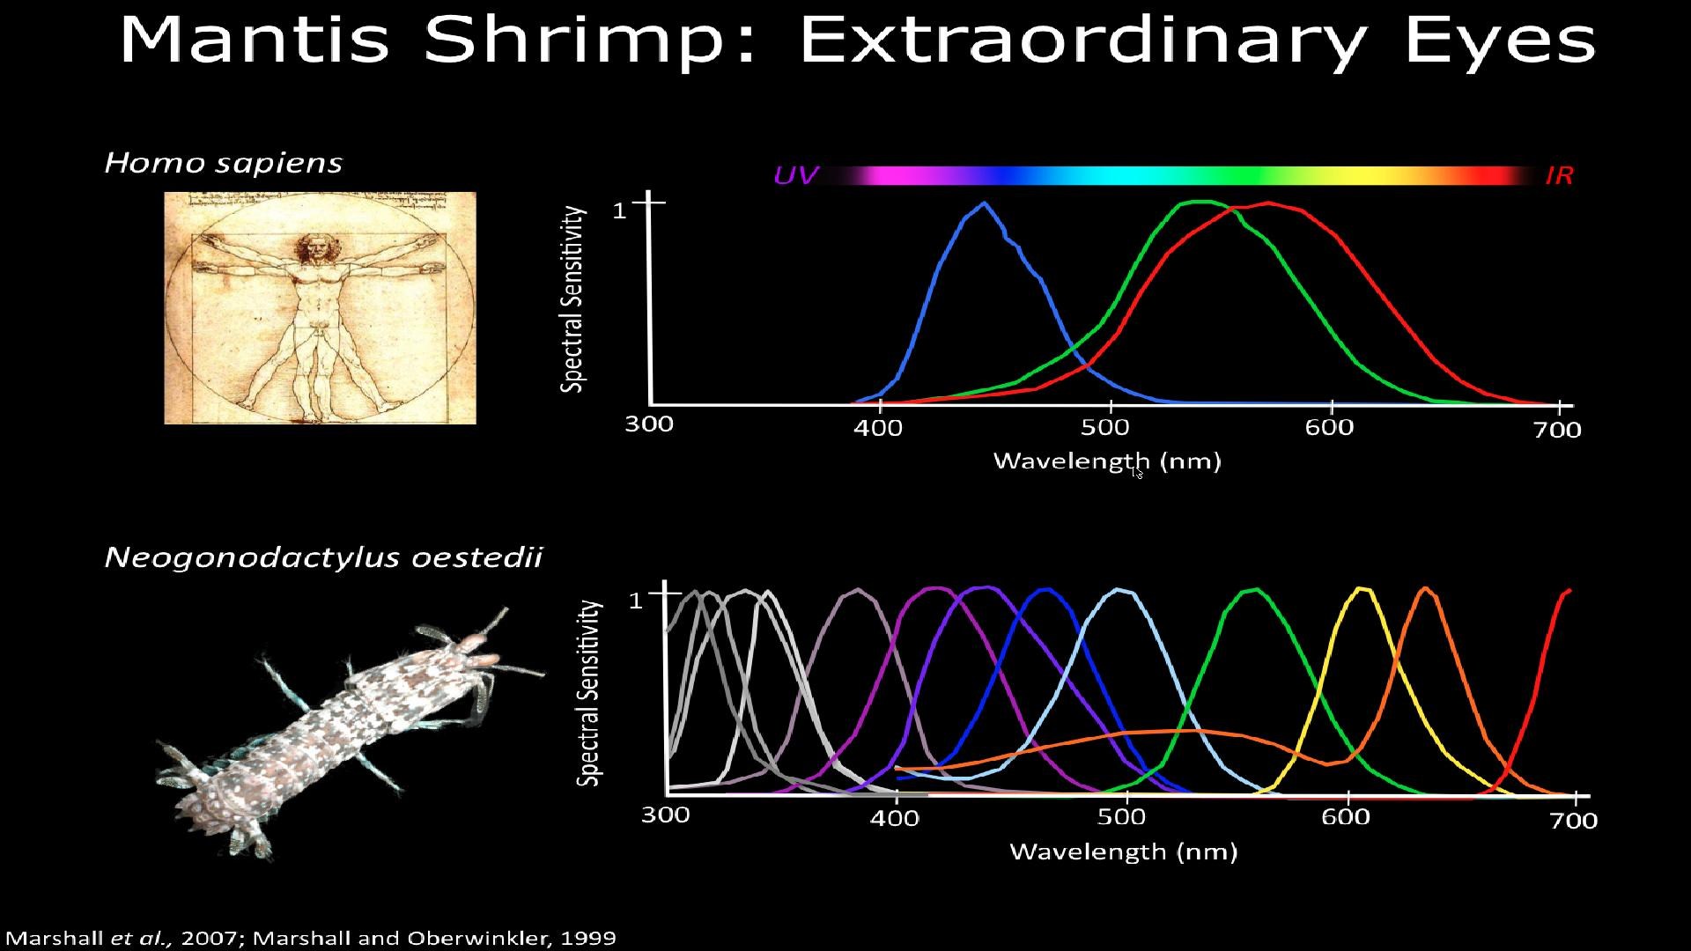

Slide 5
DISCOVERING EARTH RESOURCES IN SRI LANKA USING
HYPER SPECTRAL IMAGERY (HSI)
Objective : To pinpoint the earth resource locations in the country

Slide 6
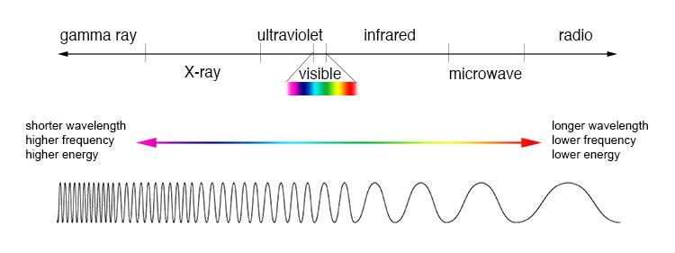
3 colour bands

Slide 7
103 colour bands

Slide 8
Why HSI?
RGB photographs do not show any difference for a land with or without a certain mineral underneath.
But these minerals tend to reflect/emit the EM waves differently in other bands of the spectrum.

Slide 9
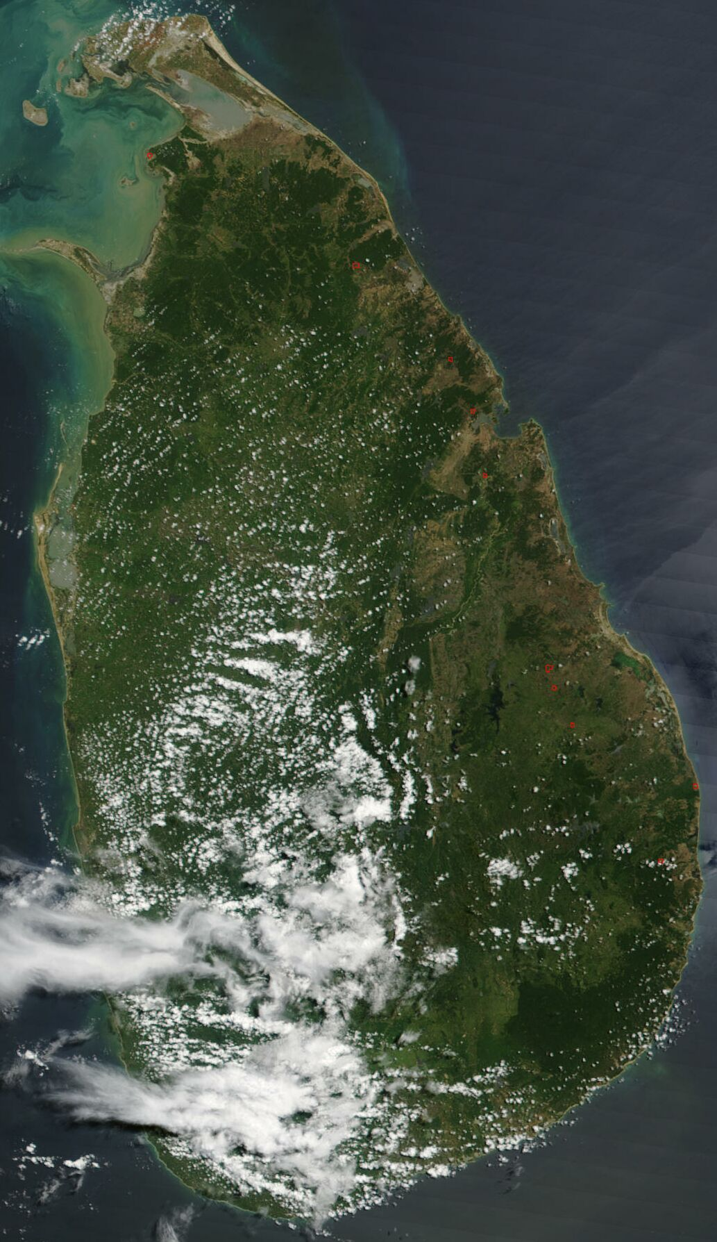

Slide 10
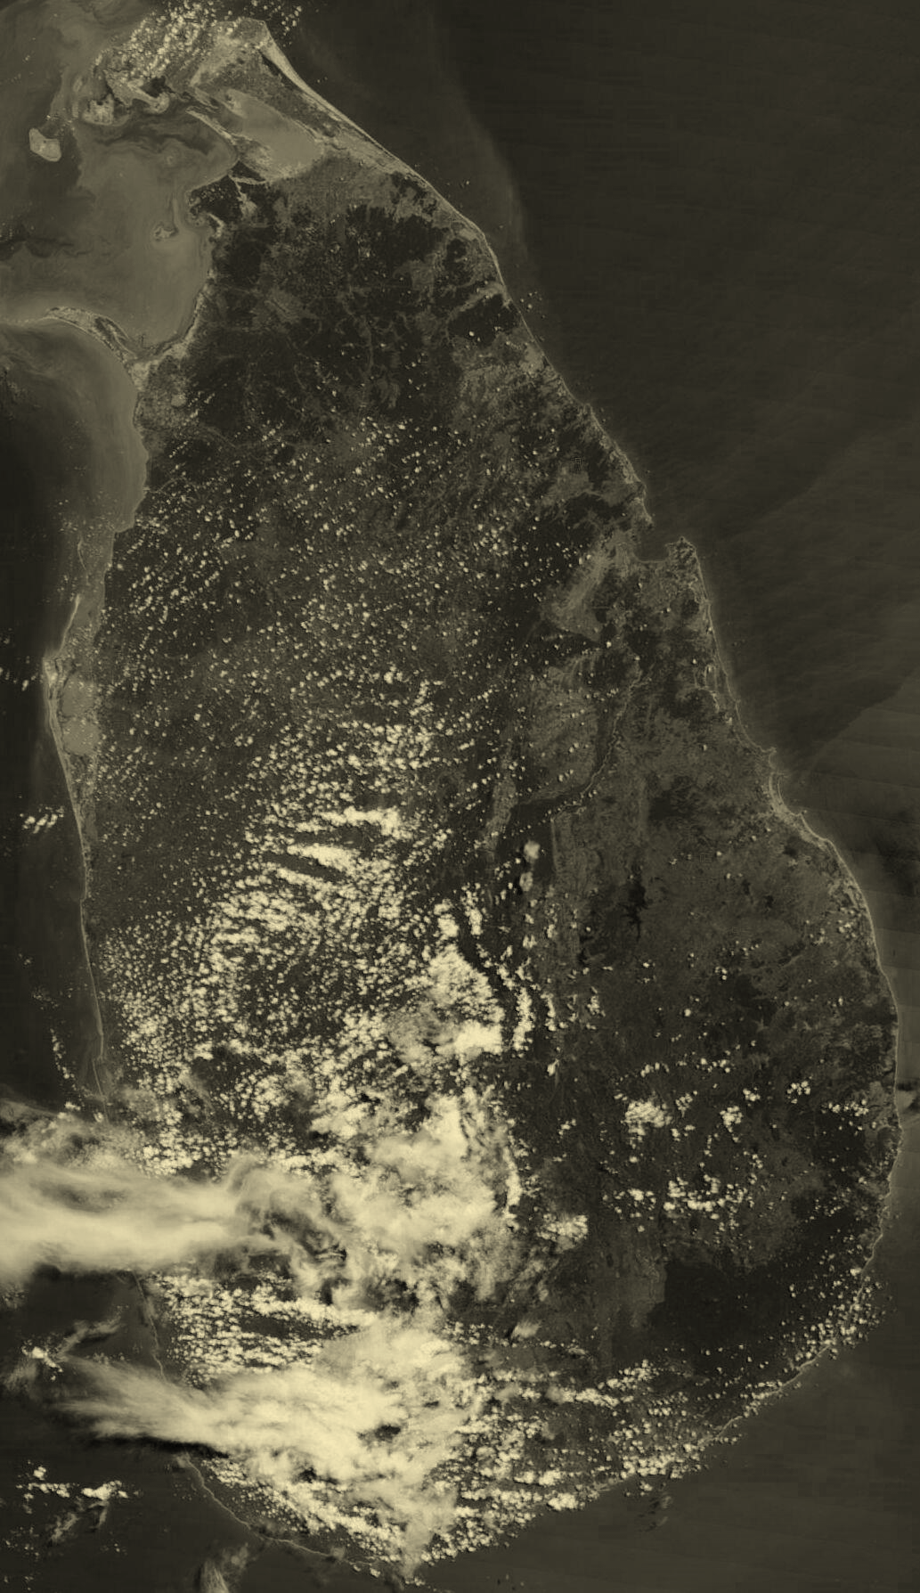

Slide 11


Slide 12
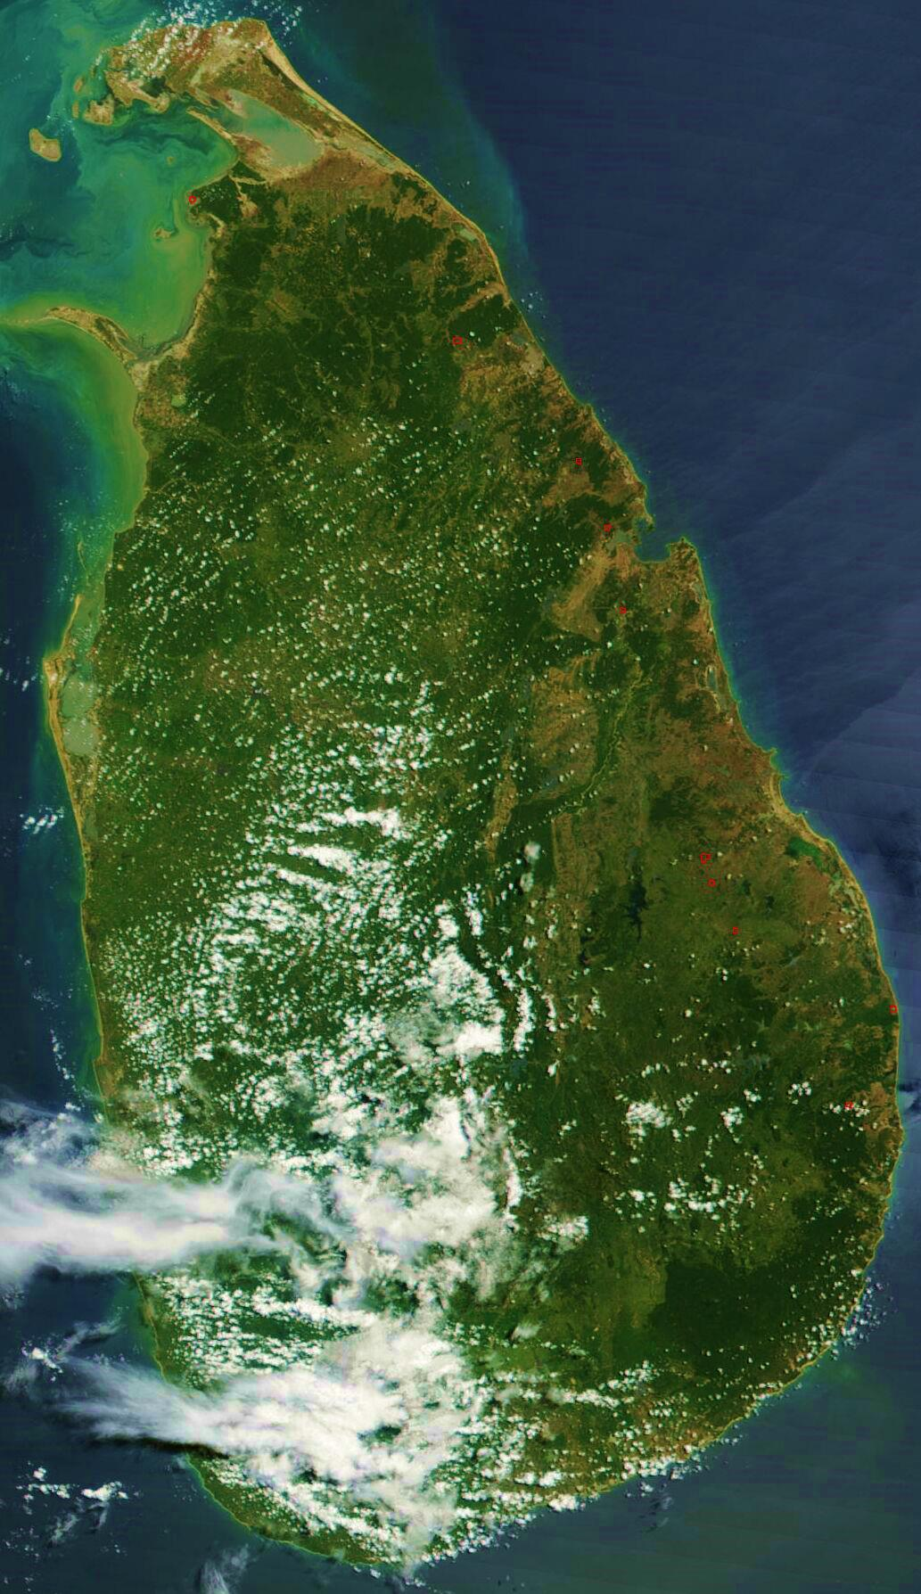

Slide 13
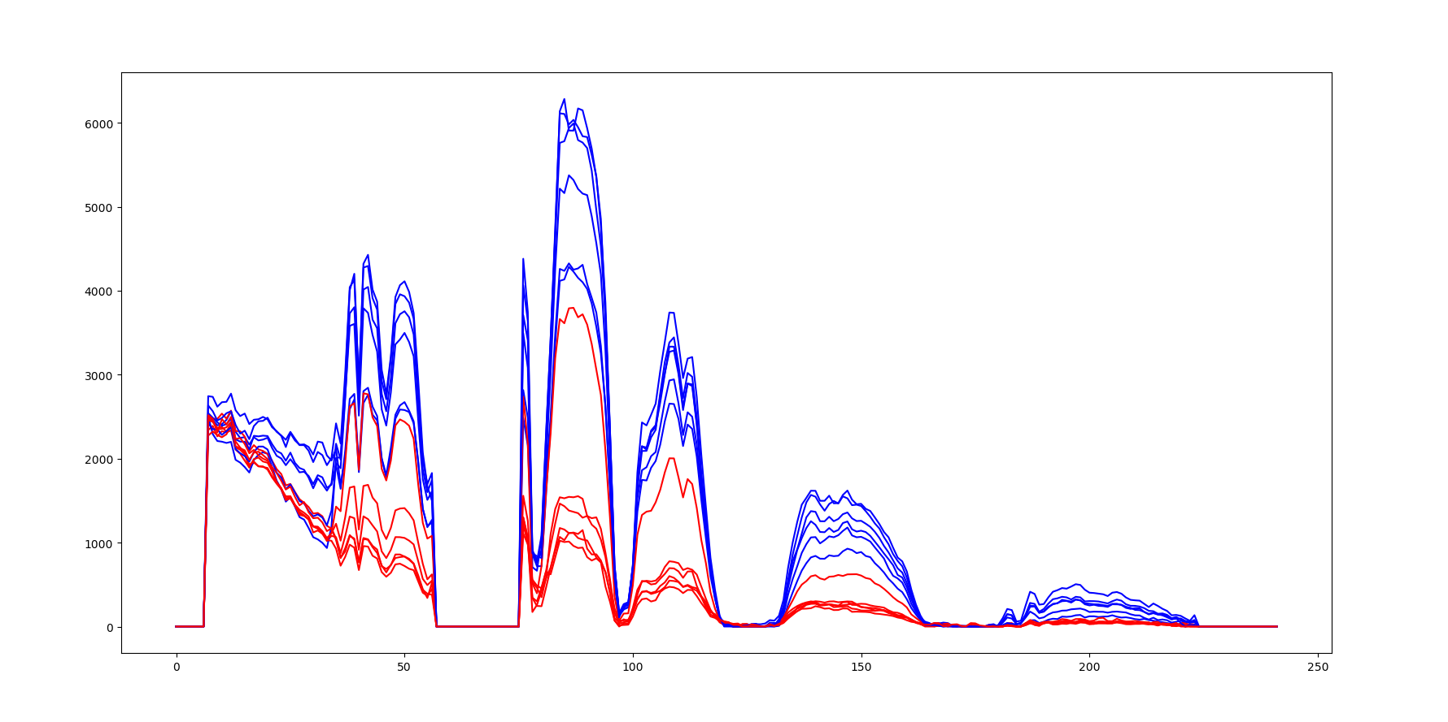

Slide 14
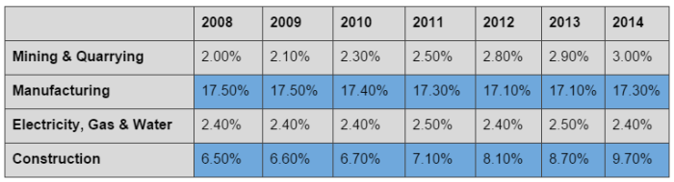

Slide 15
Impact
Sri Lanka earns 1.2 Billion USD per annum from mining earth resources.
But this is less than 2% of the GDP.
Reliable and cheap prediction WHERE to mine can increase the mining by a several fold.

Slide 16
Thank you!

